Slide 1

Hate Crimes in California
Project 1

Slide 2
Notes
More types of charts in the slides
Get more general in summary slide
Parse out presentation speaking
Put together files in one file
Review analysis and talk about single flow
Readme file 10-points
Git hub repository professional quality 10-point

Slide 3
Team
Introduction

Slide 4
Agenda
1. Introduction - Desarae
2. Distribution of Hate Crime in California - Karan
3. Crime types - Wes
4. Hate Crime - Shreenidhi
5. Summary - Ryan

Slide 5
Question and resources
Question
How did the years of Covid19 affect the Hate Crime Rate in California 2019/20 to 2022.
Resources
FBI Crimes csv files
Hate Crimes
Hate Crimes by gender
California Open Data Portal (data.ca.gov)
Statewide Covid-19 Hospital County Data
Geoapify
Assumptions
Add links appendix

Slide 6
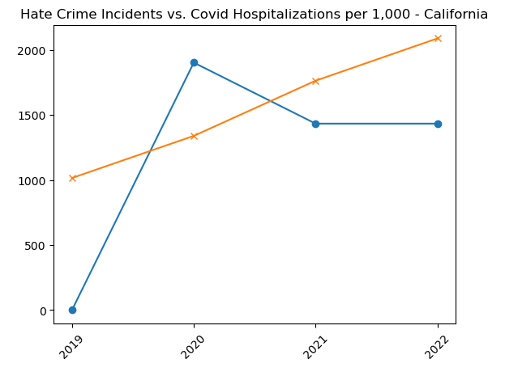
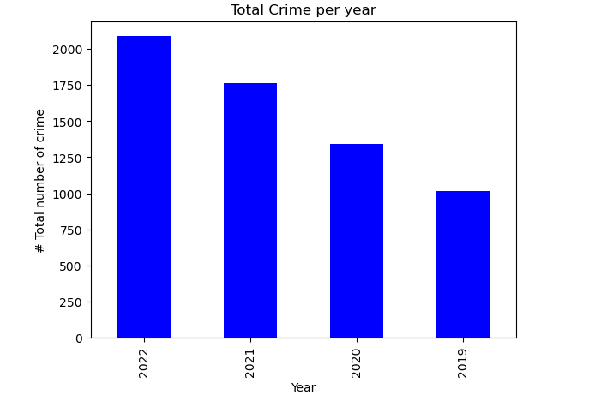
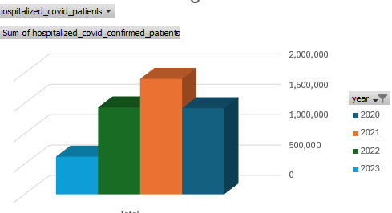

Slide 7
Hate crime Distribution map in California

Slide 8
How many people were arrested in the crimes what were committed

Slide 9
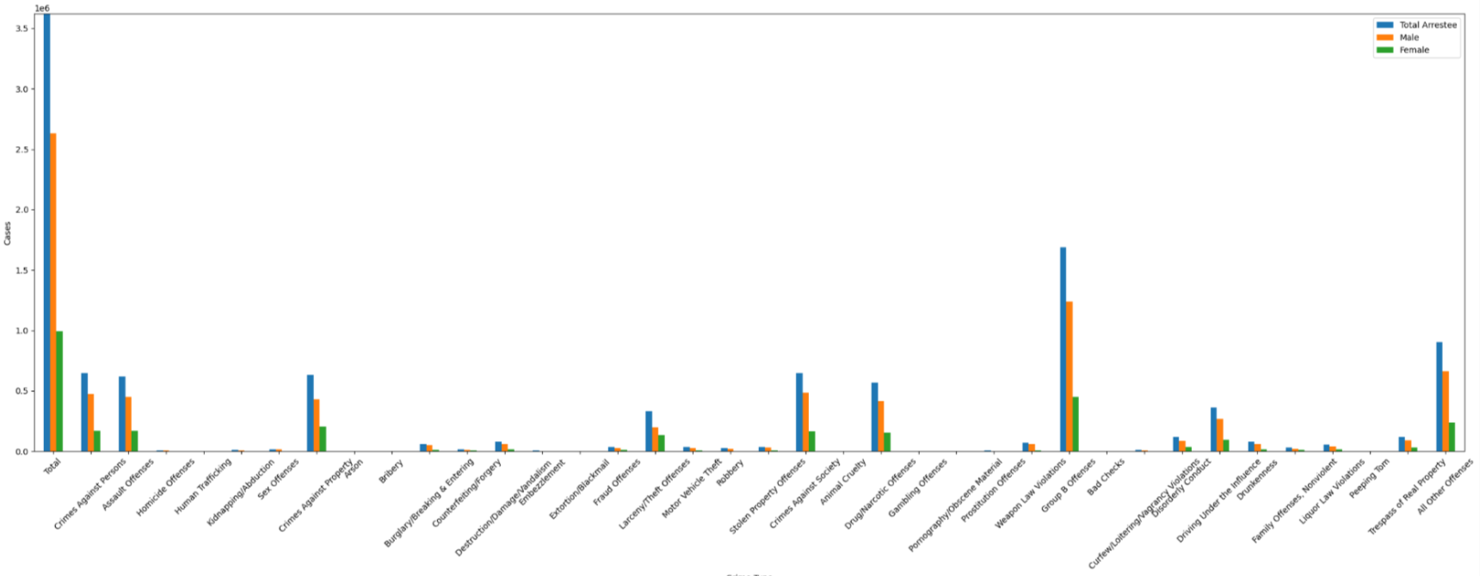
Hate crime by gender

Slide 10
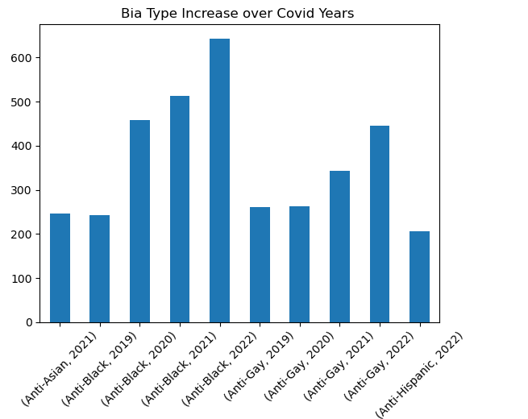
Types of hate crimes that increased
Notice the increase by Bia Type per year.

Slide 11
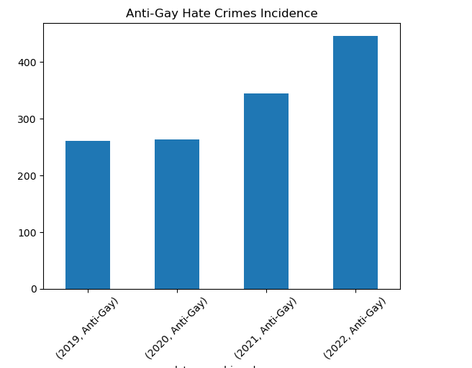
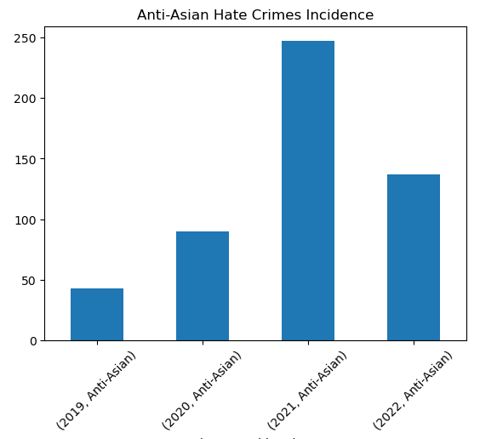
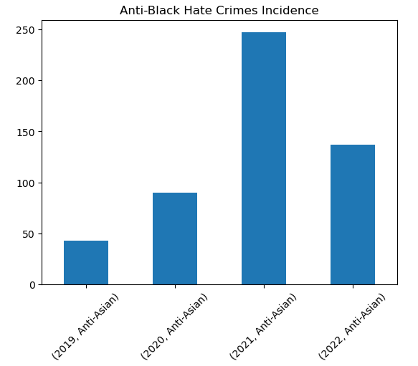
What types of hate crimes increased significantly
300%

Slide 12
Summary
Distribution statement
Gender statement
Major Cities are where the majority of hate crimes take place, but during covid the data shows that hate crimes were more prevalent in all California also
165 out of 253 Cities did not have hate crime in 2019, but during covid they did.
60 Cities decreased or stayed the same (Max 6 incidences a year)
5 Cities increased by
Need more years to determine if Hate Crimes will go back to pre-covid levels

Slide 13
Questions

